Slide 1

Sales Exploratory Data Analysis & Business Insights
Presented By- Pooja Shrivastava

Slide 2
Agenda
What We Will Cover Today
Project Objective & Data Overview
High-Level Sales Trends
Customer Demographics & Retention
Product & Seller Performance
Purchasing Behaviour & Payment Trends
Conclusion & Future Scope

Slide 3
Data Overview & Objective
Understanding the E-commerce Ecosystem
Objective: To analyze historical sales data to extract actionable business metrics and understand market dynamics
Data Scope: Merged multiple datasets including Customers, Orders, Payments, Products, and Sellers.
Scale: Consolidated and analyzed over 112,000 order instances.
Key Focus: YoY Growth, Customer Retention, and Revenue Drivers.

Slide 4
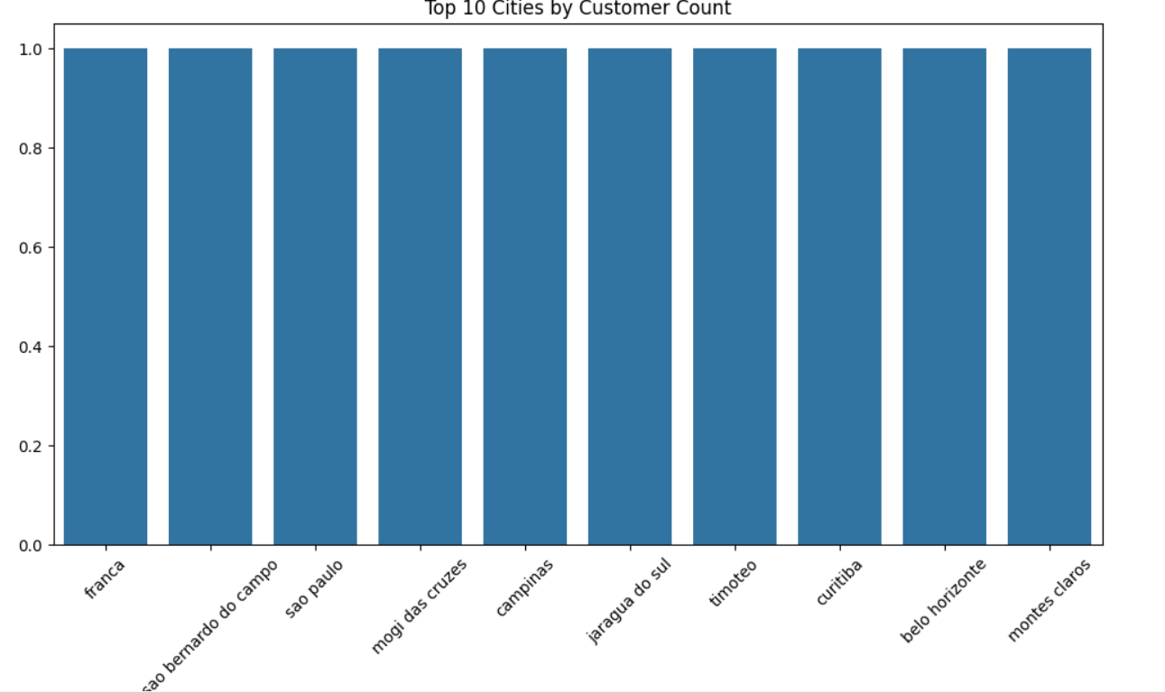
Top 10 Cities by Customer Count
Customer concentration: The chart highlights the cities with the largest customer bases.
Geographic insights: These top 10 cities represent the strongest markets, useful for regional targeting.
Operational impact: High‑volume cities may require more inventory, logistics support, and localized campaigns.
Strategic opportunities: Lower‑ranked cities outside the top 10 could be nurtured with promotions to expand reach.
Executive takeaway: This visualization connects geographic distribution to business growth, guiding expansion and resource allocation.

Slide 5
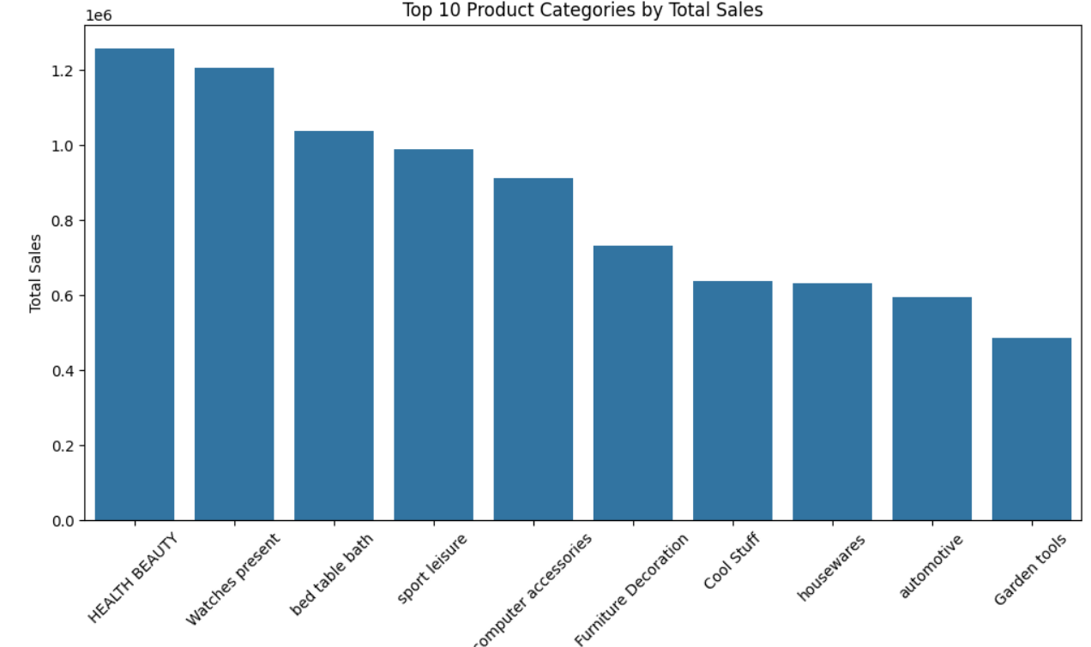
Top Product Categories Driving Sales
Revenue leaders: The bar chart highlights the top 10 categories contributing the most to total sales.
Sales concentration: A few categories dominate, showing where customer demand is strongest.
Proportional share: The pie chart (top 5 categories) emphasizes how concentrated sales are among a handful of categories.

Slide 6
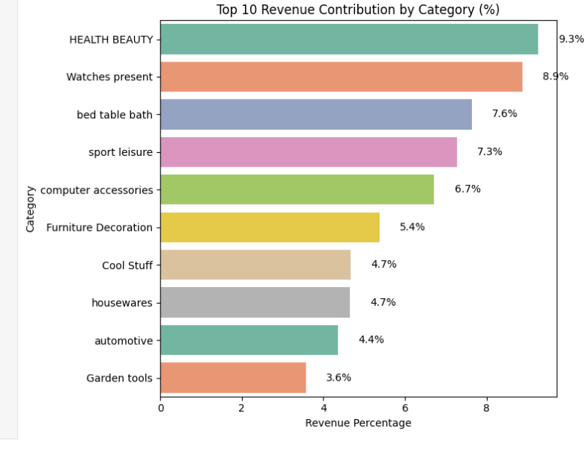
Revenue Contribution by Product Category
Top categories dominate: A handful of product categories contribute the majority of revenue.
Balanced view: The bar chart shows detailed contribution of the top 10 categories, while the pie chart simplifies the distribution into top 6 plus “Other.”
Risk of dependency: Heavy reliance on a few categories poses risk if demand shifts.
Diversification potential: The “Other” group collectively represents meaningful revenue, offering opportunities for bundling, cross‑selling, or targeted promotions.
Executive takeaway: This dual visualization balances granular detail with high‑level summary, guiding decisions on product prioritization and growth strategy.

Slide 7
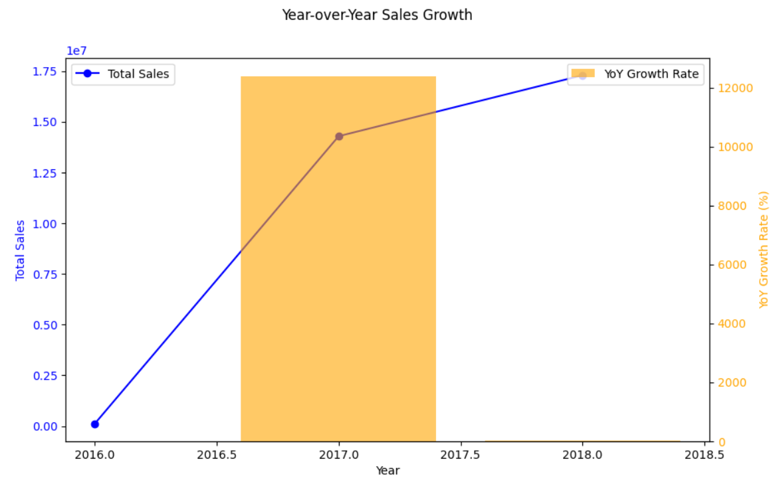
Year-over-Year Sales Growth
Total sales trajectory: The blue line shows the scale of revenue growth across years.
Growth rate dynamics: The orange bars highlight the pace of change, showing acceleration or slowdown year to year.
Dual perspective: Combines absolute performance (sales volume) with relative performance (growth rate).

Slide 8
Conclusion & Next Steps
Key Takeaways & The Road Ahead
Geographical distribution dictates where we should focus our targeted marketing efforts.
Installment payments are a strong driver for conversions and should be promoted.
Next Steps: Use these engineered features and insights to build predictive Machine Learning models for forecasting sales, anticipating churn, and optimizing inventory.

